Slide 1



NORTH WEST
UNIVERSITY
9 August 2024
CMPG 323
INTRODUCTION
IT DEVELOPMENTS

Slide 2

Content
01
Module Information
02
Contact Information
03
Overview
04
Objectives
05
Deliverables
06
Examination
07
Deliverable 1

Slide 3


Module Code:
CMPG323
Module Name:
IT Developments
Module Info
Everything you need to know about CMPG 323 in one space
NQF Level:
7
Module Credits:
16 Credits (160 Hours)
Additional Resources/Requirements for successful completion:
None
Prerequisites:
CMPG221 & CMPG 311
or ITRW222 & ITRW311
[40% Rule]

Slide 4
Tuesday Physical Class:
Communicated on Efundi w/ times
Cont.
Module Info
Everything you need to know about CMPG 323 in one space
Thursday Virtual Class:
Teams Meeting 9:30 - 10:45
(Guest Lectures)
Friday Class:
Use the slot to work on your projects

Slide 5



Contact Information
Lecturer
Potchefstroom (Distance & Contact)
Email: heiki.s.office@gmail.com
Consultation Hours: Monday, Wednesday, Thursday - 12:00 to 16:00
or via appointment
Name: Heiki Pelser
Additional Support: Available on Efundi and Class Discord

Slide 6


CMPG323
A brief overview of what this module contains

Slide 7





Cont. Assessment
Practical Development
of Skills & Knowledge
Web Dev
A personal foray into
the field of Web Dev
Overview
An introduction to the world of IT Industry and the wonderous developments that will form the basis of your future career!
Team Work
Grow your team work & communication skills
Marking Plan
Three Deliverables
Attendance
Quizzes

Slide 8




What is this all about?
The Junior Developer
The apprentices of the Software Development Team that require constant supervision and monitoring
Basic to intermediate proficiency in coding within atleast one programming language
Foundational framework founded in Computer Science or Information Technology knowledge base
Trusted with simple/low-level coding work and various odd jobs as to build experience
As their skills grow they are trusted with more responsibilities
Web Application Development
The creation of application programs that reside on remote servers
These programs are delivered to user devices via the internet
No download needed, end user can just access it through a web browser
Web App development has a short dev lifecycle and is led by a small dev team

Slide 9




Objectives
My plan for you
Objective 01
Equip you with the neccesay skills that you will apply in your day to day as a IT Industry Professional.
Objective 02
Aid you in building a portfolio that will be a useful stepping stone into the IT Industry.
North West
University
Objective 03
Have intellectual, entertaining, and enriching lecture sessions that will grow your knowledge base.
Objective 04
To pass and obtain that important piece of paper, that’s your key to the IT Professional Landscape.

Slide 10



DELIVERABLES
The Big Three
Profile
Back-End
Front-End
A professional profile that will be your key to start your search for employment
The basis for your project that will handle all computational and storage load that the Web App generates
The interface that allows access to the amazing program that your team has created over the semester
2 AUG
27 SEP
16 OCT

Slide 11





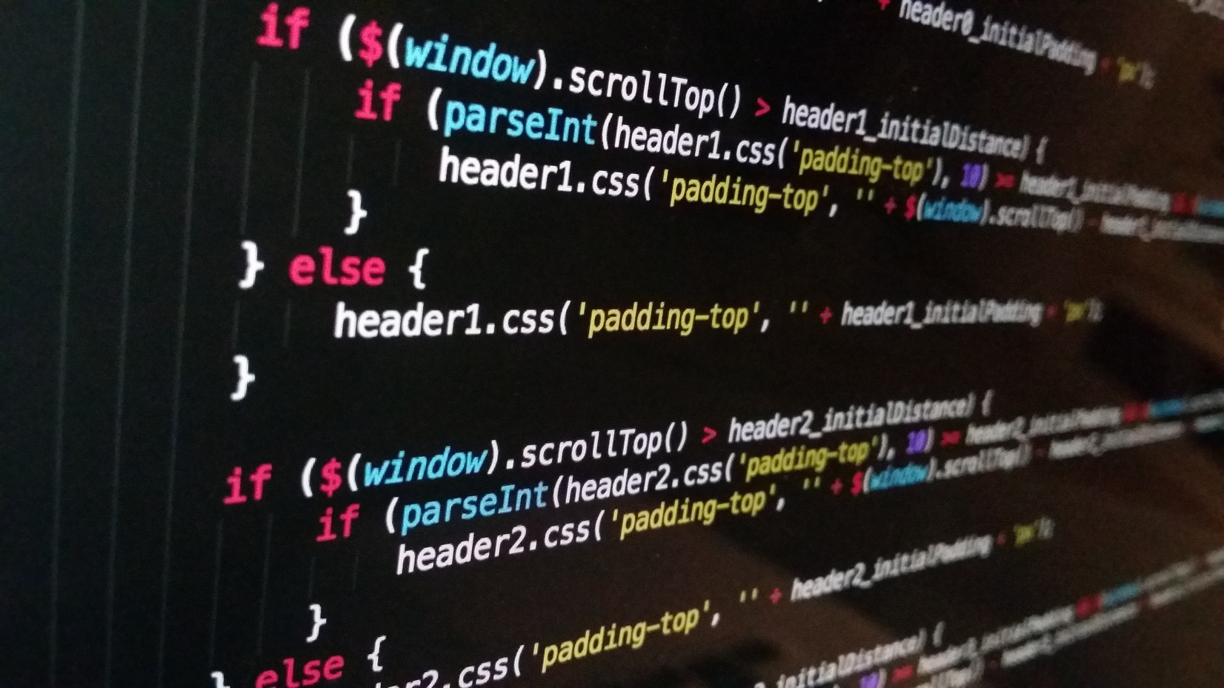
Examination
Plan
Full-Stack Web App
Final assessment will be on the full final project submitted by the group, alongside a live demonstration of its operation.
Teams Meeting
All students within a team will need to attend a Teams call where they demonstrate their project and answer questions on their project.
GitHub
Individuals will be assessed on their independant code submissions to the group’s GitHub Repo.
Industry View
Finally, Alumni from the NWU will be joining on the meeting, as to assess projects from an industry point of view.

Slide 12






Deliverable 1
Profile
Curriculum Vitae
Virtual
CV
LinkedIn
Account
Github
DUE DATE:
2 AUG
Marking Scheme will be made available at E.O.W.

Slide 13

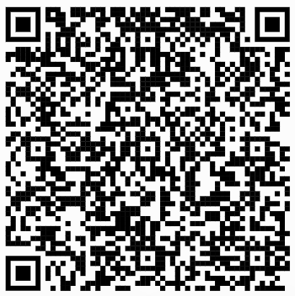

NORTH WEST
UNIVERSITY
ATTENDANCE
(closed)

